Slide 1
Drug Repurposing Prediction
Team 11 Michaelangelo Om Priscilla Sohini

Slide 2
OBJECTIVE
Predict new uses for existing drugs (drug repurposing).
Leverage drug, protein, and disease association data.
Apply ML methods to uncover hidden drug–disease patterns.
Accelerate discovery and reduce cost/time in drug development.

Slide 3
BACKGROUND
Developing a brand-new drug is extremely slow and expensive – it usually takes 10–15 years and costs $1–2 billion from discovery to approval.
Most new drug candidates fail during trials – only a small fraction ever reach patients.
Drug repurposing offers a shortcut – instead of starting from zero, we reuse drugs that are already approved and safe for humans.
This approach is faster and cheaper – timelines can drop to 5–7 years with much lower costs.
Real-world examples: Aspirin was originally for pain but is now used for heart disease; Viagra was first tested for heart problems but repurposed for erectile dysfunction.

Slide 4
BLUEPRINT & TIMELINE
Final Phase
Phase 1
Phase 2
Phase 3
Phase 4
Weeks 1-3 Data collection & preprocessing.
Weeks 4-7
Classical ML (LogReg, Decision Trees, SVM, Naïve Bayes).
Weeks 8-10 Advanced ML (ANN, CNN, RNN).
Weeks 11-12 Comparative analysis, visualization.
Weeks 13-14 Report, dashboard, and presentation.

Slide 5
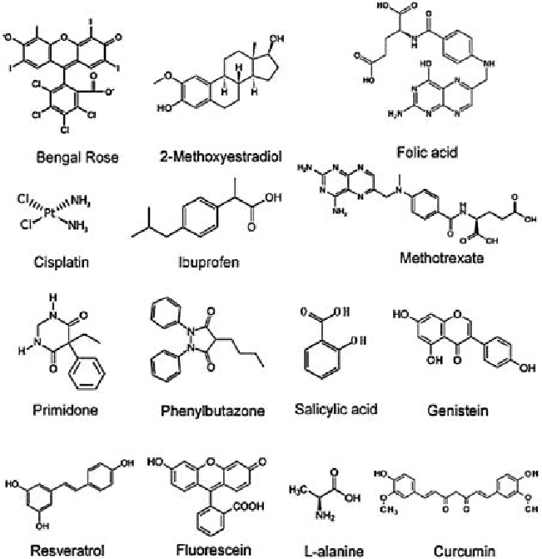
BACKGROUND RESEARCH PHASE 1
Collected datasets: DrugBank (drug targets, structures), CTD (drug–disease links).
Built drug–disease feature matrix for ML modeling.
Encoded SMILES into chemical fingerprints.
Mapped diseases to gene associations and clusters.

Slide 6
CHALLENGES IN PHASE 1
Different datasets use different identifiers and formats – for example, DrugBank, CTD, and gene databases don’t always use the same naming conventions, making it hard to merge them.
Many associations were missing or incomplete – some drugs lacked target information, and some diseases were not fully mapped to genes.
Our solution was to create a consistent mapping system – by using standard biomedical ontologies (drug IDs, disease codes), we could align data from multiple sources.
We built a preprocessing pipeline – this automatically cleans, merges, and standardizes the data into a single ML-ready format, ensuring that all features are comparable across datasets.

Slide 7
Train baseline models (LogReg, Decision Tree, Naïve Bayes, SVM).
Evaluate models using F1-score, AUROC, accuracy.
Improve features with similarity metrics & embeddings.
Conduct PCA/clustering for drug family visualization.
NEXT STEPS

Slide 8
POTENTIAL CHALLENGES & MITIGATION
How we’ll address this challenge
Class imbalance
Far more negative drug–disease pairs than positives.
Use weighted loss functions and balanced sampling to prevent bias.
Data Sparsity
Incomplete or missing associations across datasets.
Enrich features with graph-based similarity measures.
Model Interpretability
Complex neural models behave like black boxes.
Apply SHAP values, attention weights, or explanation tools to make predictions more transparent.

Slide 9
Phase II Overview
Focus: build a predictive model for the drug; what diseases can a certain drug cure?
Implemented two gradient boosting algorithms: LightGBM and XGBoost.
Worked with a larged, merged biomedical dataset(~2 GB)
Evaluated Top-K accuracy, precision/recall, and overfitting.

Slide 10
Problem Reminder
Task: Given a drug, predict which diseases it could treat.
This is a multi-class/multi-label style problem with 245 disease classes.
Output is ranked; we care if the correct disease is in the Top K predictions
Goal: Building a model that can
generalize to unseen
drug-disease pairs.

Slide 11
Challenges
No public available dataset that can
comprehensively map drugs to
potential secondary/alternative diseases
beyond their approved usages.
So, we had to build it ourselves, merging:
DrugBank
For drug information, targets, and structure
CTD
For primary drug-disease relationships
BioSNAP Disease-Drug Association Network
For drug ID ←→ disease ID mapping
Problem: Each source uses different ID’s, naming conventions, etc.

Slide 12
Addressing Additional Challenges
Class imbalance: some diseases are common, others extremely rare
Treated prediction as ranking (Top-K), not just single-label classification
High label space: 245 disease classes is very hard for Top-1 accuracy
Used boosting trees, which are more robust on sparse tabular bio features
Search space: many drugs can map to many possible diseases (one-to-many)
Monitored overfitting gap and generalization, not just raw train accuracy

Slide 13
Why Gradient
Boosting?
We chose LightGBM and XGBoost because they:
Handle large tabular data efficiently.
Handle nonlinear interactions between features
Scale millions of rows using optimized tree boosting.
Can deal with missing values without heavy changes.
Training time is reasonable for a 2GB dataset.
Are used in Kaggle-style biomedical tabular problems.

Slide 14
How to Interpret
Top-K Accuracy:
Top-1: model’s #1 predicted disease exactly matches the true one.
Top-5 / Top-10: true disease appears in the top K ranked predictions.
Clinical motivation: in repurposing, we don’t need 1 perfect guess. We need a shortlist of plausible diseases to test in the lab
LightGBM and XGBoost both show that the shortlist
(Top-10 / Top-20) is meaningful

Slide 15
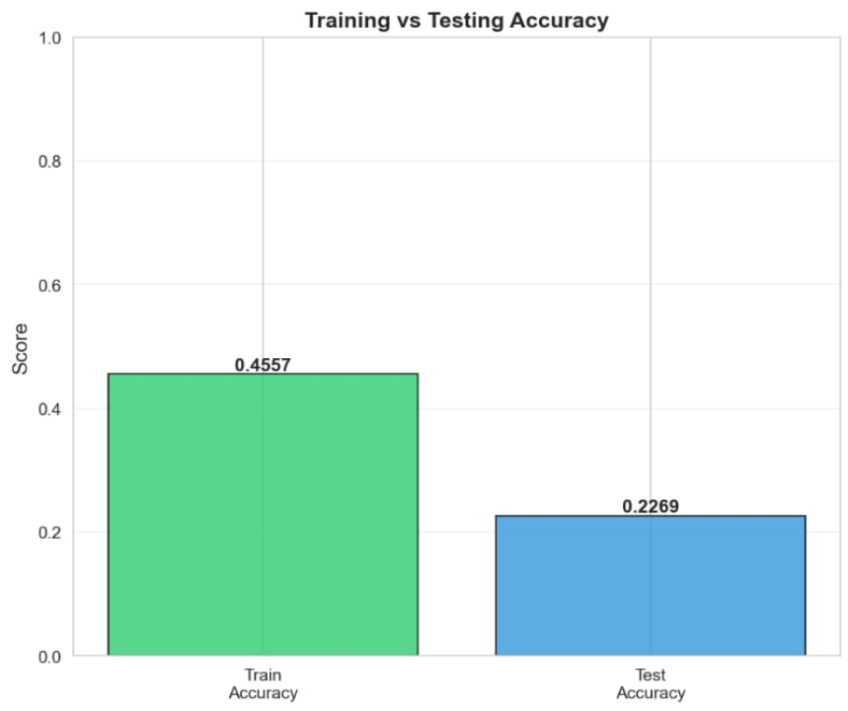
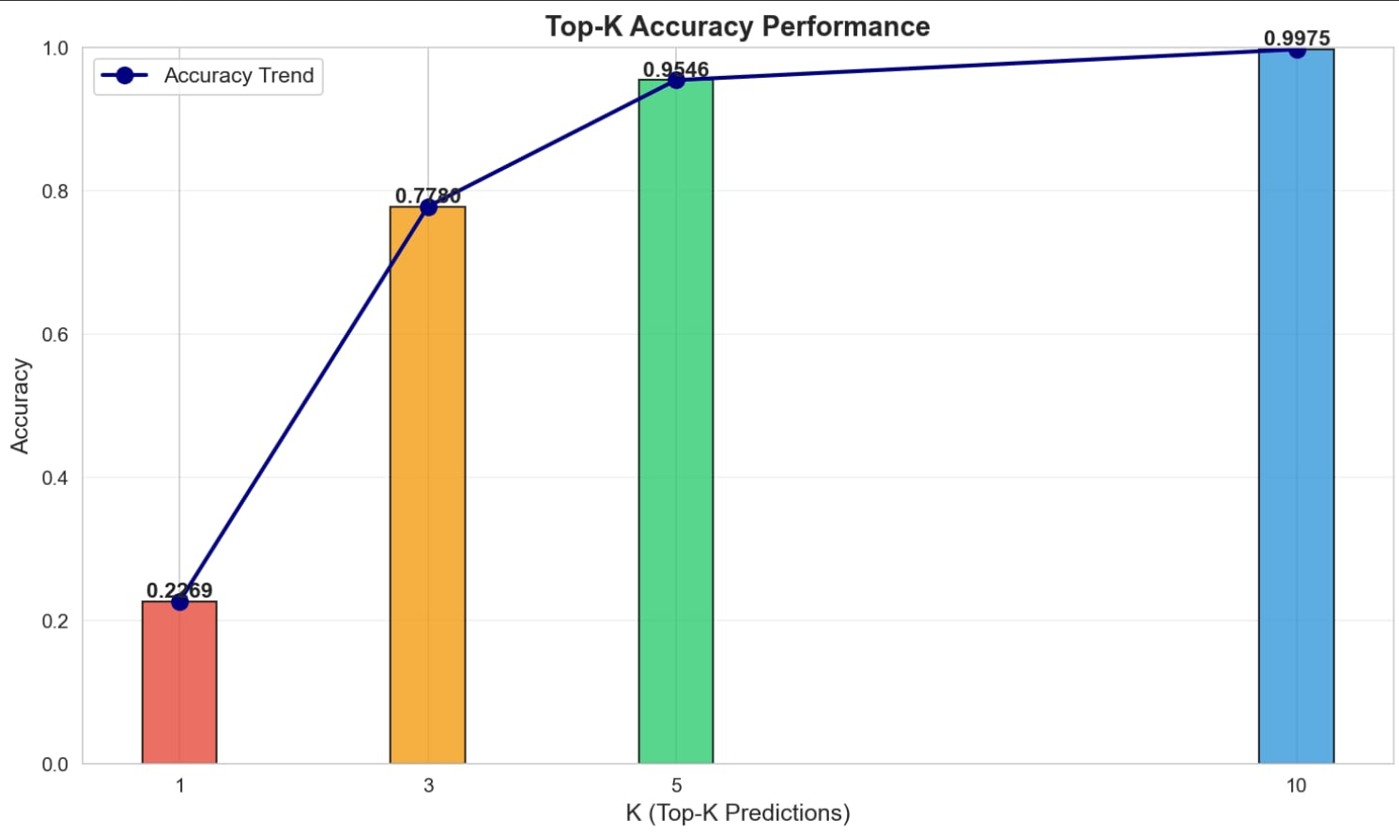
XGBoost Training Summary
Training Accuracy: 0.455684
Test Accuracy (Top-1): 0.226886
Top-3 Test Accuracy: 0.777981
Top-5 Test Accuracy: 0.954565
Top-10 Test Accuracy: 0.997488
Interpretation: for most drugs, the correct disease is somewhere in the top 10 predicted diseases

Slide 16
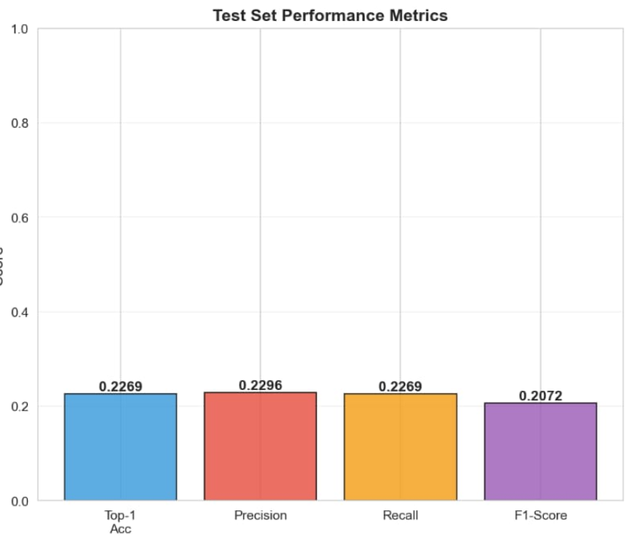
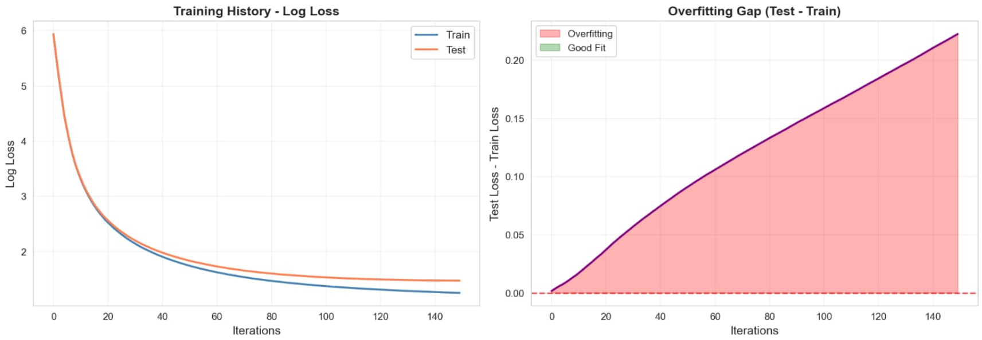
XGBoost Quality Metrics
Weighted Precision: 0.229605
Weighted Recall: 0.226886
Weighted F1-Score: 0.207171
Overfitting Gap: 0.228799 (~22.88%)
Model fits training data better than test → mild overfitting
Training loss dropped from 5.936 → 1.251,
Test loss dropped from 5.938 → 1.473
Both train and test loss go down a lot ⇒ model is actually learning signal, not random

Slide 17
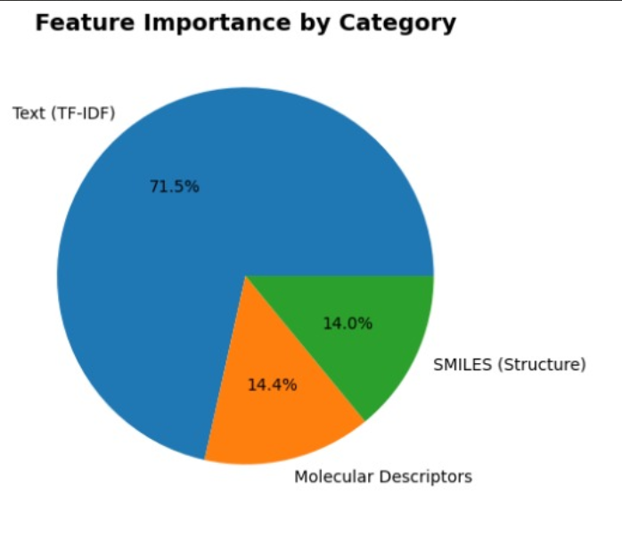
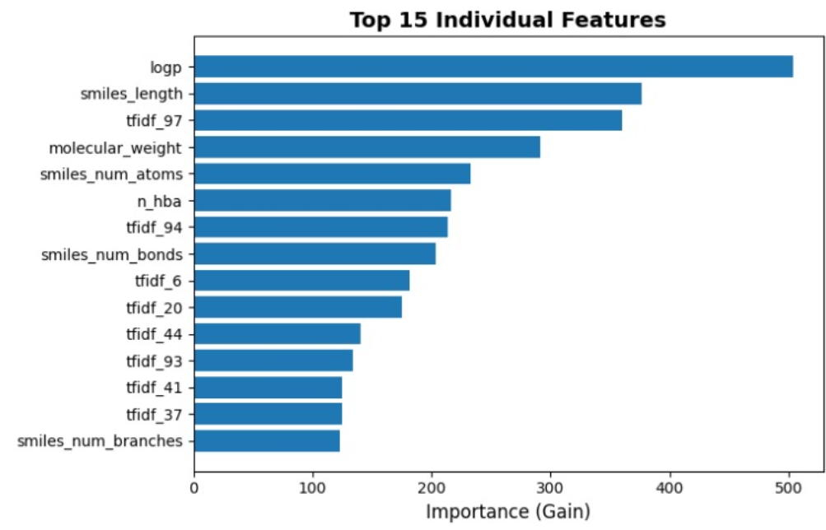
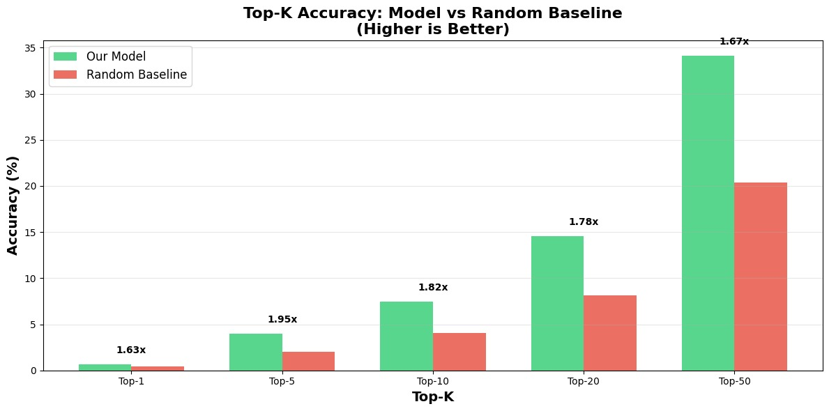
LightGBM Evaluation (Top-K Focus)
Total disease classes: 245
Top-1 Accuracy: 0.66% vs 0.41% random 1.63× better than random guess
Top-5 Accuracy: 3.98% vs 2.04% random 1.95× better than random guess
Top-10 Accuracy: 7.44% vs 4.08% random 1.82× better than random guess
Top-20 Accuracy: 14.55% vs 8.16% random 1.78× better than random guess
Top-50 Accuracy: 34.12% vs 20.41% random 1.67× better than random guess

Slide 18
Current Limitations
Exact Top-1 accuracy is still low because:
Too many possible disease classes
245-way classification problem
High overlap between diseases
similar / related conditions
Some drugs legitimately treat multiple diseases
“ground truth” is fuzzy
Dataset may still have noise / incomplete mappings
Model may confuse biologically similar diseases with shared pathways
Possibly missing important biological embeddings (e.g. target protein networks)

Slide 19
Issues Before Final Phase
We Need:
Higher recall at lower K
(e.g. Top-5, not just Top-50)
Improve per-disease coverage:
some rare diseases barely appear in
training
better negative sampling / balancing to avoid dominance of common diseases
Need more biologically meaningful features (pathways, gene expression, etc.)
interpretability: why did the model think Drug X helps Disease Y?

Slide 20
Blueprint:
Prepare final phase presentation + write up
Create final visual report.
For a given drug, show top predicted diseases + confidence
Add class-weighting/ focal loss style approaches for rare diseases.
Tune hyperparameters for LightGBM / XGBoost to close overfitting gap.
Expand dataset; Add more curated biomedical links to reduce noise.

Slide 21
Phase III Overview
Focus: building the best type of ML model to see what diseases a certain drug can cure.
Implemented CatBoost, and DNN with PyTorch.
Working on same dataset, Evaluating Top-K accuracy, precision/recall, overfitting, and prediction confidence.

Slide 22
Problem Reminder:
Task: Given a drug → predict which diseases it could treat
245 disease classes → extremely high-dimensional classification
Goal: Find the best model architecture for Top-K ranking
Dataset: Same 2GB merged biomedical set used in Phase 2

Slide 23
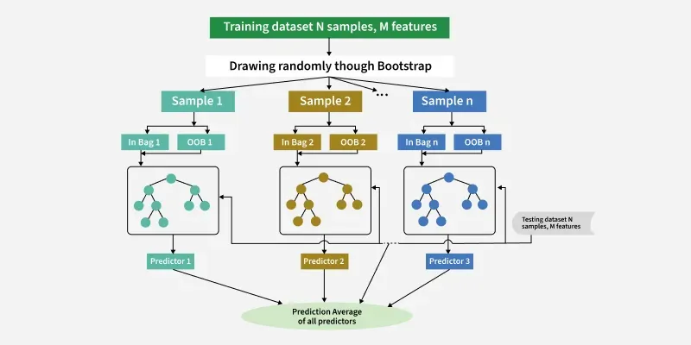
Why CatBoost?
CatBoost can be a better fit on large datasets because it works well “out of the box,” especially with lots of categorical features, so you spend less time on feature engineering and tuning than with XGBoost or LightGBM.
Built-in categoricals – handles categories natively, no manual encoding
Less tuning – strong defaults, fewer hyperparameters to tweak
Leakage-aware – ordered statistics reduce overfitting on big data
GPU-friendly – efficient training and inference at scale

Slide 24
Challenges with:
Cat Boost
Although powerful, CatBoost is extremely slow on large datasets.
Could only run on a 50,000-row sample; estimated 47 days to train on the full 2GB dataset (~1.2M rows × 27 features).
The task is a 245-class problem, and many classes are rare or imbalanced; this hurts Top-1 accuracy and F1-score.
CatBoost works best with categorical features, but our dataset is mostly numeric and drug IDs are converted into integer indices, so CatBoost’s main advantage doesn’t apply.

Slide 25
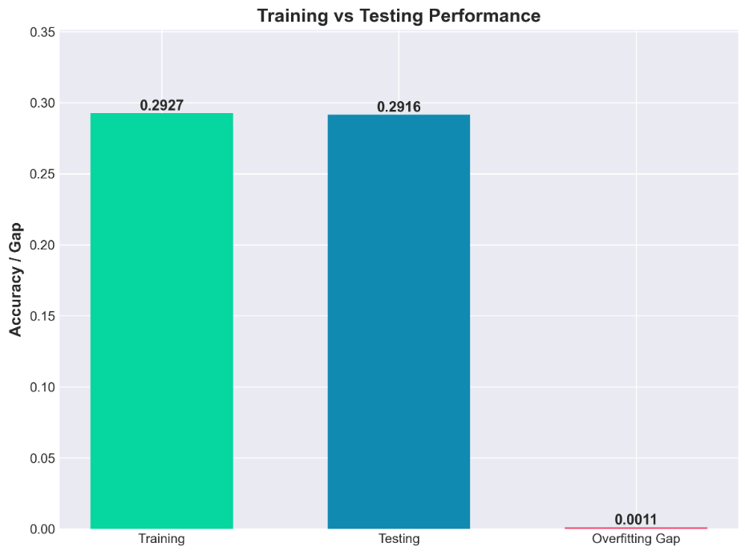
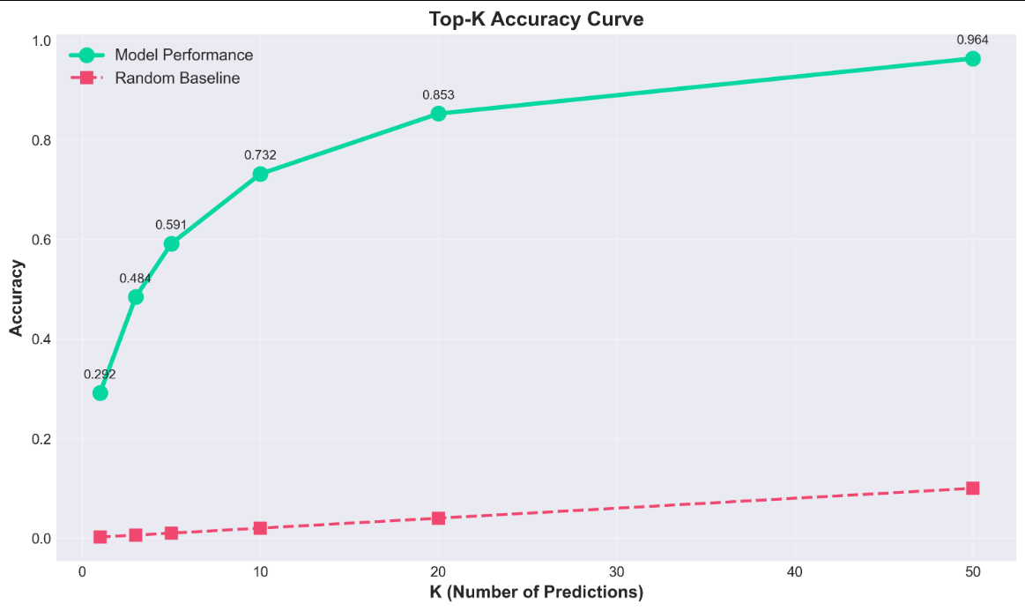
CatBoost Training Summary
Training Accuracy: .2927
Test Accuracy(Top-1): 0.2916
Top-3 Test Accuracy: 0.484
Top-5 Test Accuracy: 0.591
Top-10 Test Accuracy: 0.732
Top-20 Test Accuracy: 0.853
Top-50 Test Accuracy: 0.964
Interpretation: for most drugs, the correct disease is somewhere in the top 50 predicted diseases

Slide 26
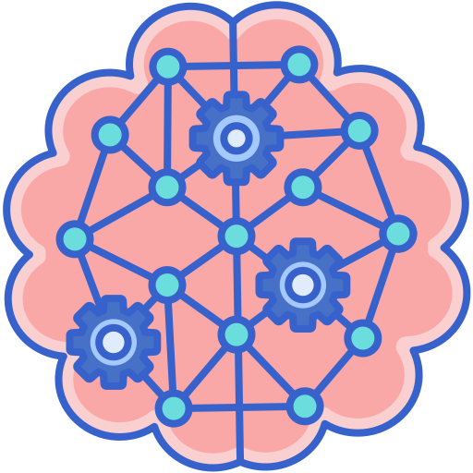

Why Deep Neural Network
Why this algorithm on large data? A deep neural network with embeddings scales well to huge, high-dimensional data and can learn richer patterns than tree models like XGBoost/LightGBM.
High-dim features – Handles large TF-IDF + numeric spaces
Embeddings – Compact vectors for high-cardinality IDs
GPU training – Fast on very big datasets
Flexible – Easy to add new feature types (text, molecules, etc.)

Slide 27
Challenges with:
DNN with Pytorch
DNNs need large datasets, with less noise and dense, high quality features. Our dataset is large, but noisy and sparse.
245 disease classes in dataset, with many diseases appearing rarely, and some classes only appear a few times. These are issues since DNNs overfit to common diseases and ignore rare diseases.
Hyperparameters are hard to tune. DNN tuning is more sensitive, chaotic, and takes longer to set up well.

Slide 28
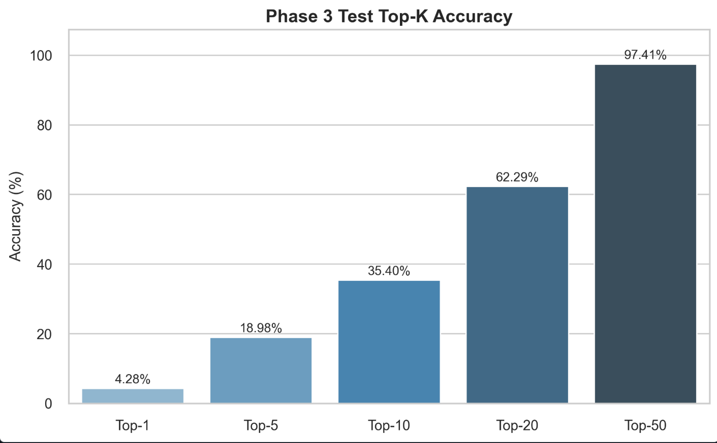
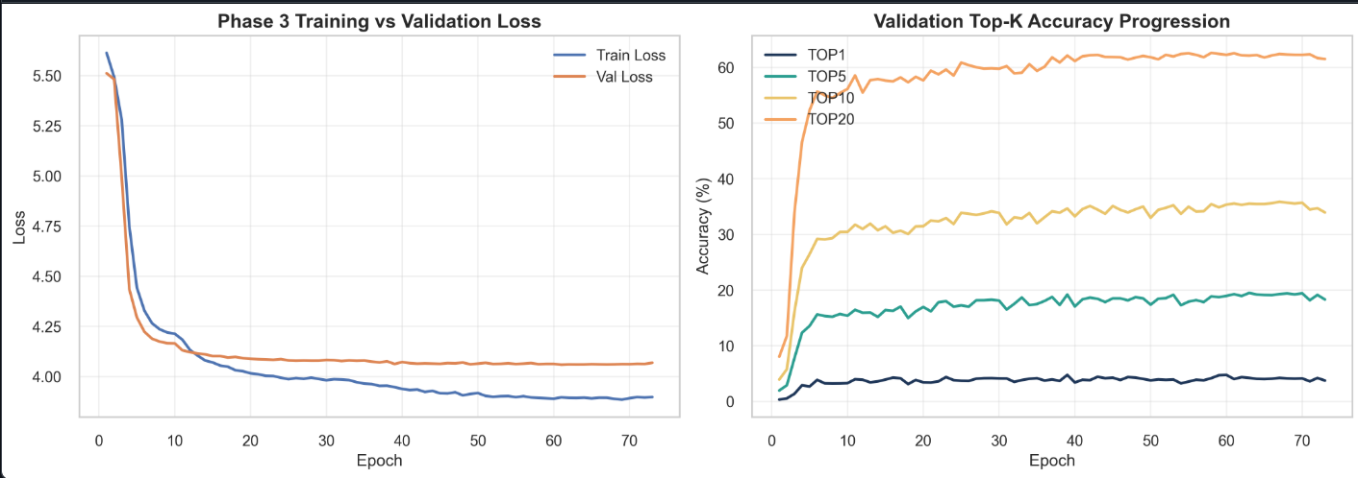
DNN Training,
Top-K Accuracy
Testing Accuracy(Top-1): .0428
Top-5 Test Accuracy: 0.1898
Top-10 Test Accuracy: 0.3540
Top-20 Test Accuracy: 0.6229
Top-50 Test Accuracy: 0.9741
Interpretation: for most drugs, the correct disease is somewhere in the top 50 predicted diseases.
DNN learned real signal and remained stable in beginning.
Then it began to mildly overfit and quickly reached a performance plateau
Deep learning struggles to generalize well on this sparse, imbalanced 245-class dataset.

Slide 29
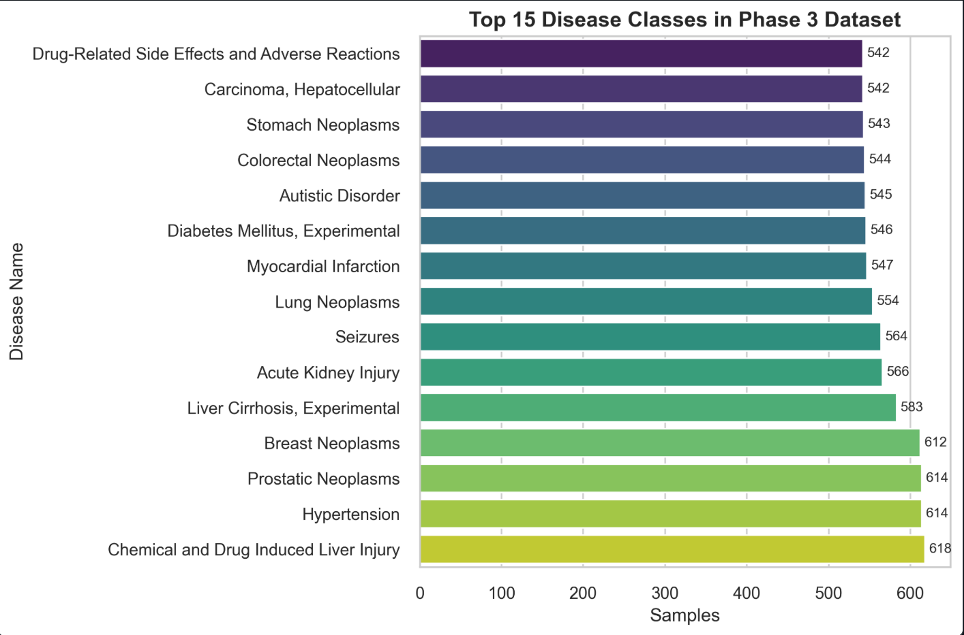
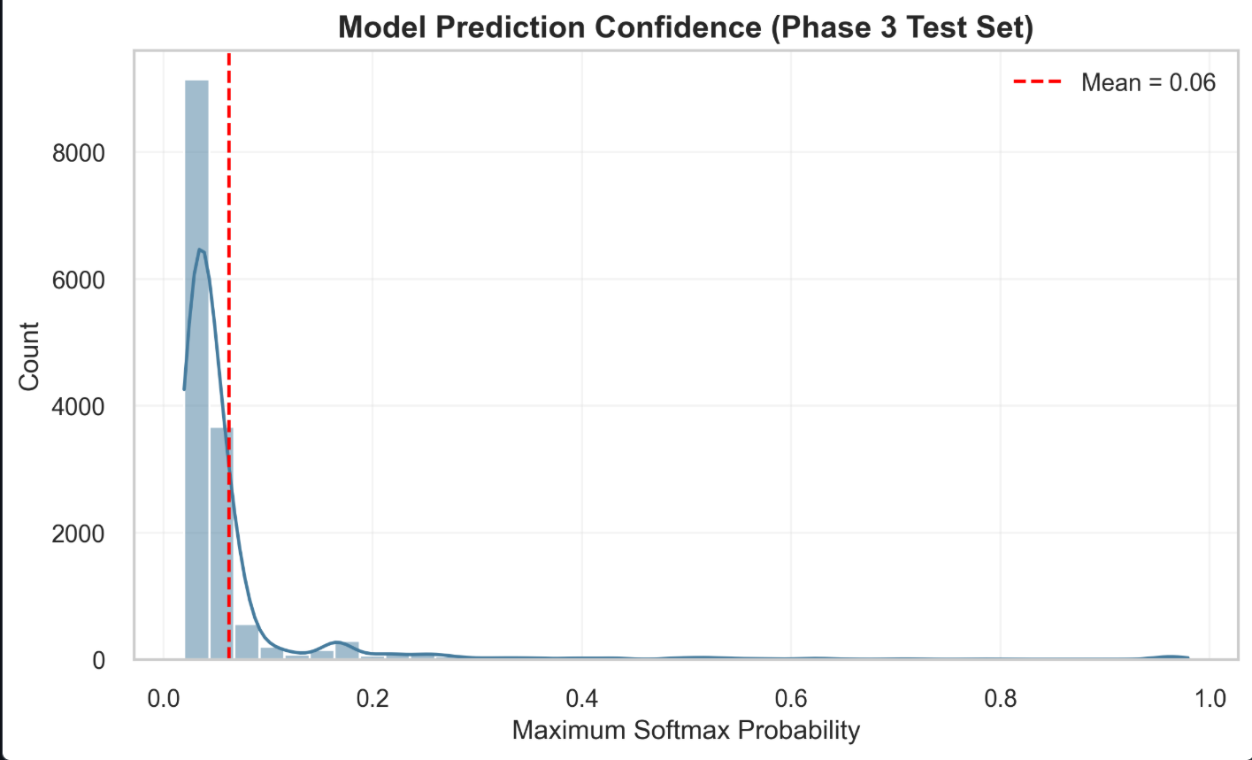
DNN Confidence, Top Disease Classes
Dataset is highly imbalanced, with many rare diseases.
Deep learning models need many examples per class, so the DNN struggles to learn strong decision boundaries.
As a result, the DNN produces very low confidence (mean softmax ≈ 0.06), reflecting uncertainty across the 245 disease classes.
This highlights why boosting models perform better.

Slide 30

Main Challenges of the Project
There is no final dataset available on the internet about drug repurposing.
The data which we have created by merging 3 datasets is very big.
In our dataset we have less drugs but more diseases. (so, it is difficult to predict diseases from new drugs)
We have not achieved accuracy above 29% for Top 1 because of the above reasons.

Slide 31


Potential future possibilities
New Dataset
If we can find or create new dataset on drug to disease relations and it has same number of drugs to diseases.
Computing Power
In CatBoost, if we use it properly, it needs more time for learning process (nearly 30 to 40 days in system like our laptop).

Slide 32

Results of Our Algorithms (Visualization)
#1
Lightbgm
#2
XGBOOST
#3
CATBOOST
#4
DEEP NEURAL NETWORK
0.66 %
22.6%
29.1 %
0.4 %

Slide 33
Conclusion:
XG-Boost almost guarantees the
correct disease is in the Top-10.
Top-3: 0.778, Top-5: 0.954, Top-10: 0.997
CatBoost is good, but not as strong, and only
performed well on a small sample of the dataset.
Top-3 = 0.484, Top-5 = 0.591, Top-10 = 0.732
LightGBM is the weakest gradient boosting model,
with a Top-5 = .0398 and Top-10 = .0744
DNN with Pytorch was only best at a very high K
(Top-50), but had low confidence.
To analyze this large, ~1.2GB dataset for repurposing diseases to other drugs, XGBoost yielded
the best results. The
Top-K accuracies
prove this.
XGBoost achieved
the highest Top-K accuracy, best generalization,
and strongest
ranking
performance.

Slide 34
Thank
You

Slide 35
References
Stanford Network Analysis Project (SNAP).
DCh-Miner Dataset (DCh-Miner: Drug Combination Miner). Stanford University.
Available at: snap.stanford.edu/biodata/datasets/10004/10004-DCh-Miner.html
Guillemart, S.
DrugBank Dataset. Kaggle.
Available at: kaggle.com/datasets/sergeguillemart/drugbank
Comparative Toxicogenomics Database (CTD).
CTDbase: Chemical–Gene–Disease Interactions.
Available at: ctdbase.org
GeeksforGeeks.
XGBoost – Extreme Gradient Boosting Algorithm in Machine Learning.
Available at: geeksforgeeks.org/machine-learning/xgboost/
GeeksforGeeks.
LightGBM – Light Gradient Boosting Machine.
Available at: geeksforgeeks.org/machine-learning/lightgbm-light-gradient-boosting-machine/
CatBoost
CatBoost - open-source gradient boosting library
Available at: catboost.ai
PyTorch
PyTorch - Build the Neural Network
Available at: docs.pytorch.org/tutorials/beginner/basics/buildmodel_tutorial.html

